Slide 1

Analyzing the Impact of Car Features on Price and Profitability
By
Stan Pereira

Slide 2
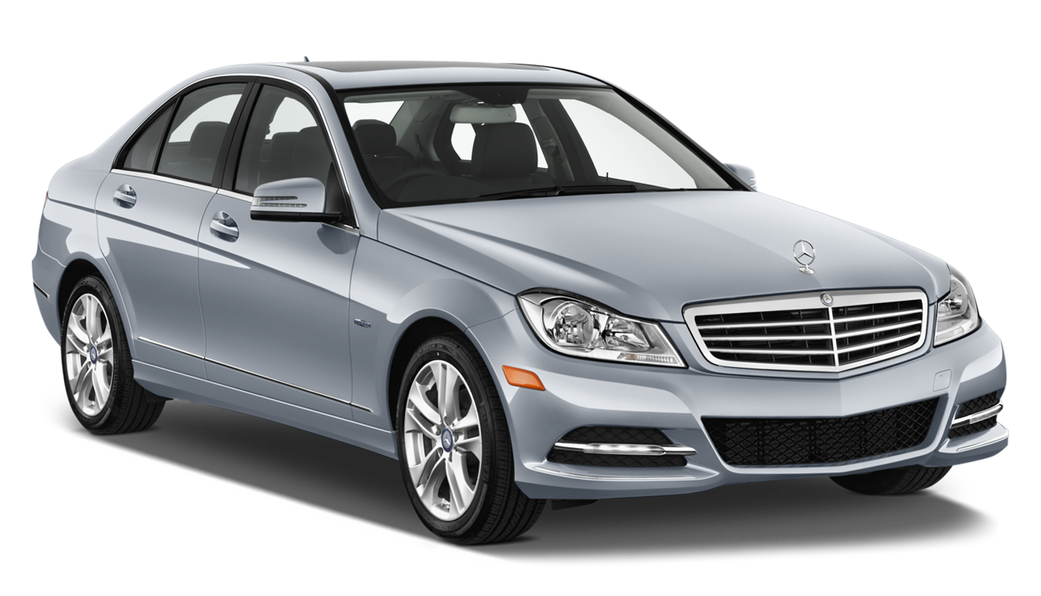
Project Description
The automotive industry has been rapidly evolving over the past few decades, with a growing focus on fuel efficiency, environmental sustainability, and technological innovation. With increasing competition among manufacturers and a changing consumer landscape, it has become more important than ever to understand the factors that drive consumer demand for cars.
This problem could be approached by analyzing the relationship between a car's features, market category, and pricing, and identifying which features and categories are most popular among consumers and most profitable for the manufacturer. By using data analysis techniques such as regression analysis and market segmentation, the manufacturer could develop a pricing strategy that balances consumer demand with profitability, and identify which product features to focus on in future product development efforts. This could help the manufacturer improve its competitiveness in the market and increase its profitability over time.
ThePhoto by PhotoAuthor is licensed under CCYYSA.

Slide 3
Approach
Understand the data – Understand the dataset, features and impact on other columns.
Analyze Data – Analyze the data to find various relationships between features to derive conclusions.
Visualization – Visualize the data using Tables, Charts and Dashboards.
Clean the data - Identify Missing Data and Deal with it Appropriately.

Slide 4
Tech Stack Used
Microsoft Excel 2010 Version 14.0.7628.5000
Ability to perform calculations, data analysis, data visualization, data transformation, and data cleaning with Excel tools and functions.
Transform and clean data with features like Power Query and Flash Fill.
Code to automate tasks and customize functions with VBA (Visual Basic for Applications).
Availability of free templates and code to customize and automate Excel.

Slide 5
Understanding the Data
Table Information (Original)
Total Rows | 11914
Total Columns | 16
Total Blanks | 108
Duplicates | 715
Table Information (After Cleaning)
Total Rows | 11199
Total Columns | 16
Total Blanks | 0
Duplicates | 0

Slide 6
Data Cleaning – Distribution of Blanks
Columns | Count of Blanks
Make | 0
Model | 0
Year | 0
Engine Fuel Type | 3
Engine HP | 69
Engine Cylinders | 30
Transmission Type | 0
Driven_Wheels | 0
Number of Doors | 6
Market Category | 0
Vehicle Size | 0
Vehicle Style | 0
highway MPG | 0
city mpg | 0
Popularity | 0
MSRP | 0

Slide 7
Data Cleaning (Engine Fuel Type, Cylinders & Doors)
Engine Fuel Type
Engine Fuel Type | Count | Change To
diesel | 150 | Diesel
electric | 66 | Electric
flex-fuel (premium unleaded recommended/E85) | 26 | Flex-Fuel Premium
flex-fuel (premium unleaded required/E85) | 53 | Flex-Fuel Premium
flex-fuel (unleaded/E85) | 887 | Flex-Fuel Regular
flex-fuel (unleaded/natural gas) | 6 | Flex-Fuel Regular
natural gas | 2 | Natural Gas
premium unleaded (recommended) | 1392 | Premium Unleaded
premium unleaded (required) | 1956 | Premium Unleaded
regular unleaded | 6658 | Regular Unleaded
(blank) | 3 | Regular Unleaded. As the records have the same model and make, and the car used regular unleaded fuel type
Blank Number of Doors
Make | Model | Count of Make | New Value | Remarks
Ferrari | FF | 1 | 2 | Same as the model of another record with simiar values
Tesla | Model S | 5 | 4 | Same as the model of another record with simiar values
Engine Cylinders
Make | Model | Engine Fuel Type | Count of Make | New Value | Remarks
Chevrolet | Bolt EV | electric | 2 | 0 | Electric Vehicles have no cylinders
Mazda | RX-7 | regular unleaded | 3 | 4 | Wankel 2 engine has no cylinders but is equivalent to a 4 cylinder engine
Mazda | RX-8 | premium unleaded (required) | 17 | 4 | Wankel 2 engine has no cylinders but is equivalent to a 4 cylinder engine
Mitsubishi | i-MiEV | electric | 3 | 0 | Electric Vehicles have no cylinders
Toyota | RAV4 EV | electric | 1 | 0 | Electric Vehicles have no cylinders
Volkswagen | e-Golf | electric | 4 | 0 | Electric Vehicles have no cylinders

Slide 8
Data Cleaning (Engine HP)
Updating the Blank Engine HP (Based on Certain Factors) Size of the engine, Number of cylinders, Type of fuel injection system
Make | Model | Year | Engine Fuel Type | Engine Cylinders | Count of Make | New Engine HP | Remarks
Chevrolet | Impala | 2015 – 2017 | flex-fuel (unleaded/natural gas) | 6 | 2 | 230 | Online
FIAT | 500e | 2015 - 2017 | electric | 0 | 1 | 111 | Online
Ford | Escape | 2017 | regular unleaded | 4 | 4 | 168 | Online
Ford | Focus | 2015 - 2017 | electric | 0 | 1 | 143 | Online
Ford | Freestar | 2005 | regular unleaded | 6 | 6 | 201 | Online
Honda | Fit EV | 2013 - 2014 | electric | 0 | 1 | 123 | Online
Kia | Soul EV | 2015 - 2016 | electric | 0 | 2 | 109 | Online
Lincoln | Continental | 2017 | premium unleaded (recommended) | 6 | 4 | 400 | Online
Lincoln | MKZ | 2017 | regular unleaded | 4 | 4 | 245 | Online
Mercedes-Benz | M-Class | 2015 | diesel | 4 | 1 | 200 | Online
Mitsubishi | i-MiEV | 2014 | electric | (blank) | 1 | 66 | Online
Nissan | Leaf | 2014 - 2016 | electric | 0 | 3 | 107 | Online
Tesla | Model S | 2014 – 2016 | electric | 0 | 4 | 360 | 302,362 or 416
Toyota | RAV4 EV | 2013 - 2014 | electric | 0 | 1 | 154

Slide 9
Data Cleaning (Engine HP)
Updating the Blank Engine HP (Based on Certain Factors) Size of the engine, Number of cylinders, Type of fuel injection system
Make | Model | Year | Engine Fuel Type | Engine Cylinders | Count of Make | New Engine HP | Remarks
Chevrolet | Impala | 2015 – 2017 | flex-fuel (unleaded/natural gas) | 6 | 2 | 230 | Online
FIAT | 500e | 2015 - 2017 | electric | 0 | 1 | 111 | Online
Ford | Escape | 2017 | regular unleaded | 4 | 4 | 168 | Online
Ford | Focus | 2015 - 2017 | electric | 0 | 1 | 143 | Online
Ford | Freestar | 2005 | regular unleaded | 6 | 6 | 201 | Online
Honda | Fit EV | 2013 - 2014 | electric | 0 | 1 | 123 | Online
Kia | Soul EV | 2015 - 2016 | electric | 0 | 2 | 109 | Online
Lincoln | Continental | 2017 | premium unleaded (recommended) | 6 | 4 | 400 | Online
Lincoln | MKZ | 2017 | regular unleaded | 4 | 4 | 245 | Online
Mercedes-Benz | M-Class | 2015 | diesel | 4 | 1 | 200 | Online
Mitsubishi | i-MiEV | 2014 | electric | (blank) | 1 | 66 | Online
Nissan | Leaf | 2014 - 2016 | electric | 0 | 3 | 107 | Online
Tesla | Model S | 2014 – 2016 | electric | 0 | 4 | 360 | 302,362 or 416
Toyota | RAV4 EV | 2013 - 2014 | electric | 0 | 1 | 154

Slide 10
Data Cleaning (Other Changes)
Rename Columns
Old Name | New Name
Driven Wheels | Drive Wheels
highway MPG | Highway MPG
city mpg | City MPG
The #N/A in Market Category Column was left as is. All the Duplicate values were removed One Outlier ‘Audi A6’, had an highway MPG of 354, which was corrected to 34

Slide 11
Data Analysis

Slide 12
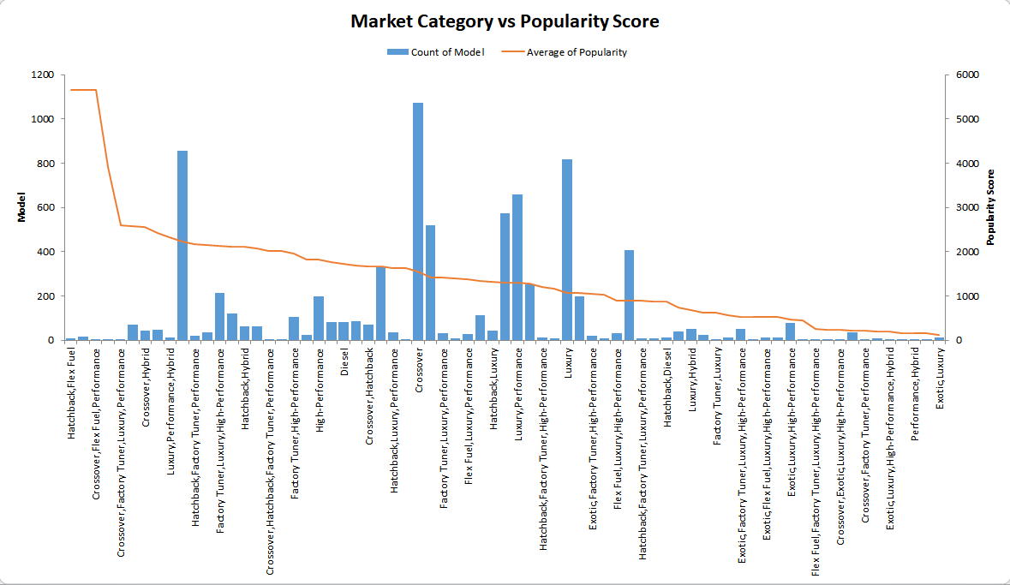
How does the popularity of a car model vary across different market categories? Task 1.A. Create a pivot table that shows the number of car models in each market category and their corresponding popularity scores. Task 1.B. Create a combo chart that visualizes the relationship between market category and popularity.
‘Crossover’ has the most number of models, but the ‘Hatchback, Flex Fuel’ is the most popular.

Slide 13
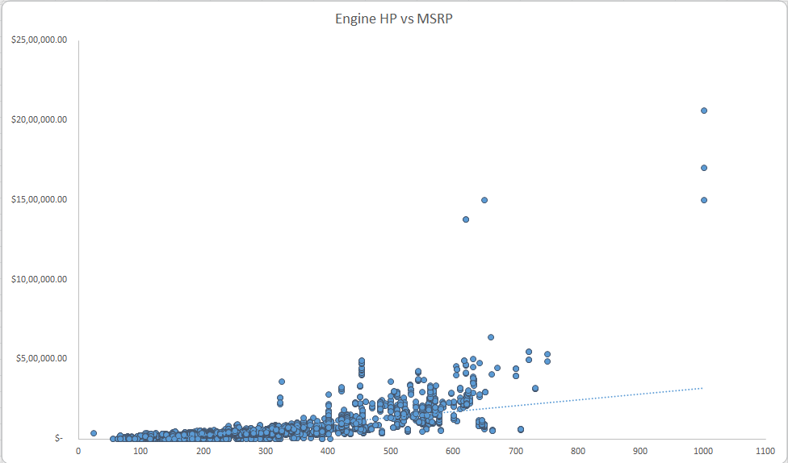
What is the relationship between a car's engine power and its price? Task 2: Create a scatter chart that plots engine power on the x-axis and price on the y-axis. Add a trendline to the chart to visualize the relationship between these variables.
‘Engine HP’ and ‘MSRP’ have a positive linear relation.
Note the Dodge Challenger which is high on HP, but low on MSRP. This could be due to other features such as low city and highway MPG, or fuel type.

Slide 14
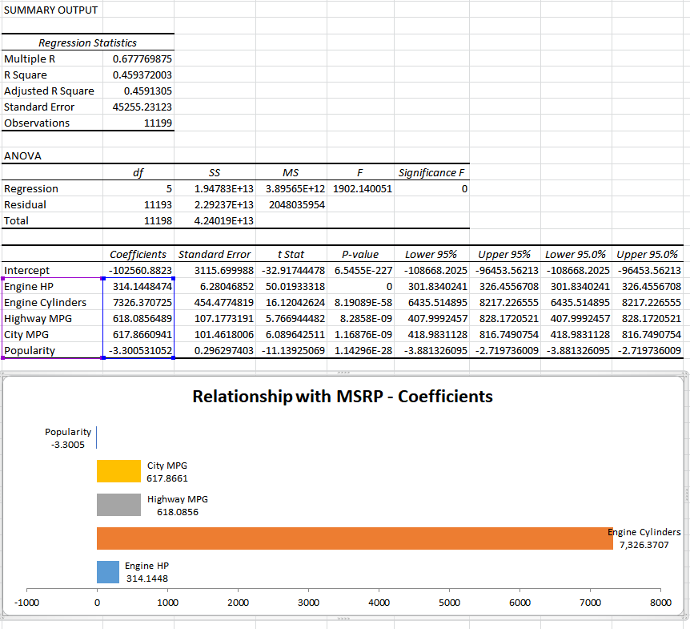
Which car features are most important in determining a car's price? Task 3: Use regression analysis to identify the variables that have the strongest relationship with a car's price. Then create a bar chart that shows the coefficient values for each variable to visualize their relative importance.
‘Engine Cylinder’ and ‘MSRP’ have the highest positive coefficient.
Whereas, ‘Popularity’ has a negative coefficient.

Slide 15
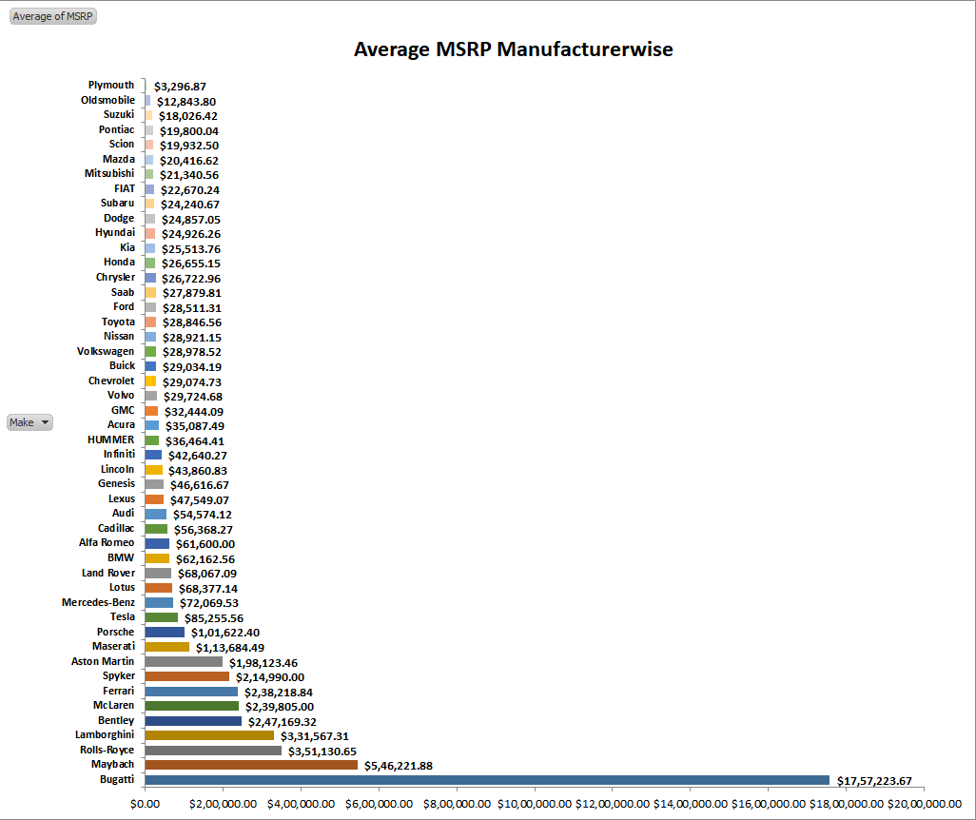
How does the average price of a car vary across different manufacturers? Task 4.A: Create a pivot table that shows the average price of cars for each manufacturer. Task 4.B: Create a bar chart or a horizontal stacked bar chart that visualizes the relationship between manufacturer and average price.
Luxury Brands like Bugatti, Maybach and Rolls-Royce were the most expensive.

Slide 16
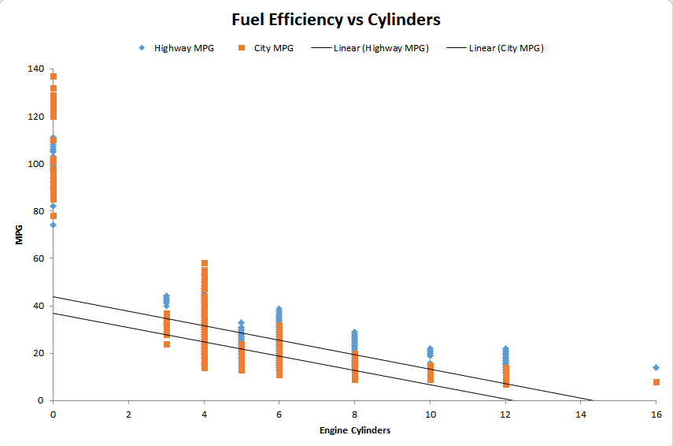
What is the relationship between fuel efficiency and the number of cylinders in a car's engine? Task 5.A: Create a scatter plot with the number of cylinders on the x-axis and highway MPG on the y-axis. Then create a trendline on the scatter plot to visually estimate the slope of the relationship and assess its significance. Task 5.B: Calculate the correlation coefficient between the number of cylinders and highway MPG to quantify the strength and direction of the relationship.
For both Highway and City MPG, as the cylinders increase, the fuel efficiency decreases.

Slide 17
Dashboard
Task 1: How does the distribution of car prices vary by brand and body style?
Task 2: Which car brands have the highest and lowest average MSRPs, and how does this vary by body style?
Task 3: How do the different feature such as transmission type affect the MSRP, and how does this vary by body style?
Task 4: How does the fuel efficiency of cars vary across different body styles and model years?
Task 5: How does the car's horsepower, MPG, and price vary across different Brands?

Slide 18
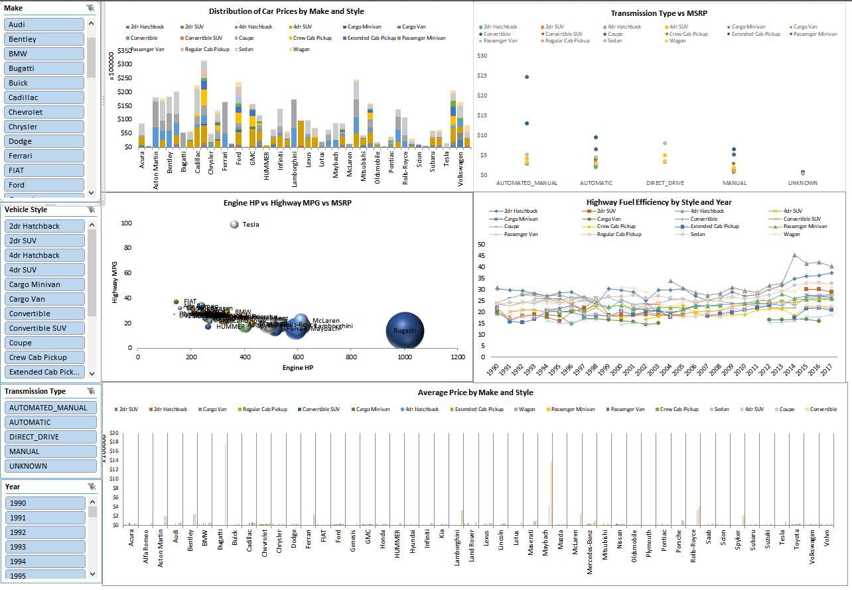
Dashboard

Slide 19
Summary
This particular project involved an extensive usage of Excel and Statistics.
Most of the analysis was done by using Pivot Tables and Charts, for which a lot of research was done.
Creating a dashboard was a new and interesting challenge, which was difficult, and could have been easily done using PowerBI or Tableau.
In Statistics, achieving the Regression Analysis for many columns together was difficult, but after researching it, was able to understand and complete the task.
The major challenge faced was in understanding the data. Updating the NULL/Missing values proved a challenge as most of the data required internet research. There were some data irregularities, which were dealt with.
Overall, this was a very challenging but creative and informative project.
Link to Excel File
Car Data.xlsx

Slide 20

THANK YOU

